Slide 1


UPB IIoT Training Bench
Portfolio Overview – Fluid Control & Pneumatics
Emerson Confidential

Slide 2
Architecture

Slide 3









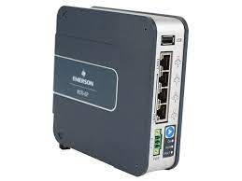
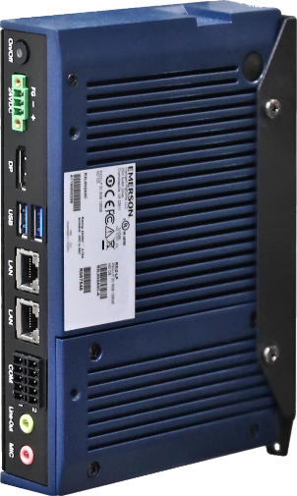
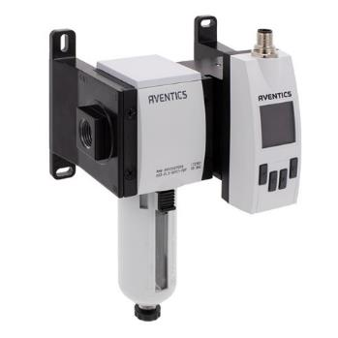
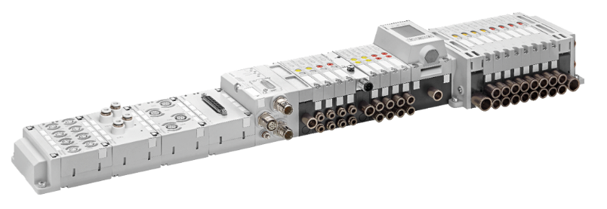
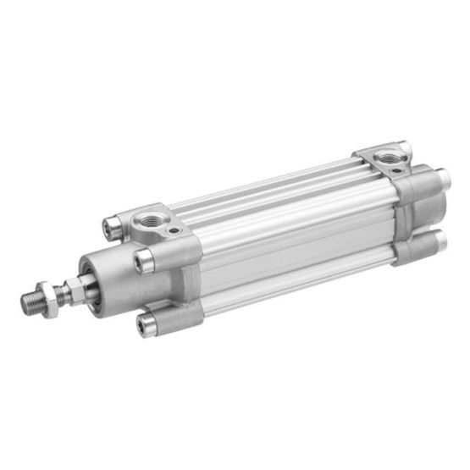
UPB IIoT Training Bench - Architecture of the system
Software & Services
Analytics
Cylinder
Speed
Detect Air Leakages
Pressure Monitoring
Compressed Air Consumption
Device Lifecycle Management
Position Feedback
Solenoid Coil Failure Detection
Control
PLC
Pneumatic
PACSystem for
Machine control
OPC UA, MQTT…
EDGE
/ GATEWAY
Data
EDGE controller
for analysis
Control
Connectivity
PNUMATIC VALVE
DISCRETE / MANIFOLD
REMOTE I/O
Data
PNEUMATICS
INTELIGENT
AIR FLOW
& PREP
GRIPPERS
& VACUUM
PNEUMATIC
SENSORS
CYLINDERS
& ACTUATORS
R480342465
R481705212
Emerson Confidential

Slide 4
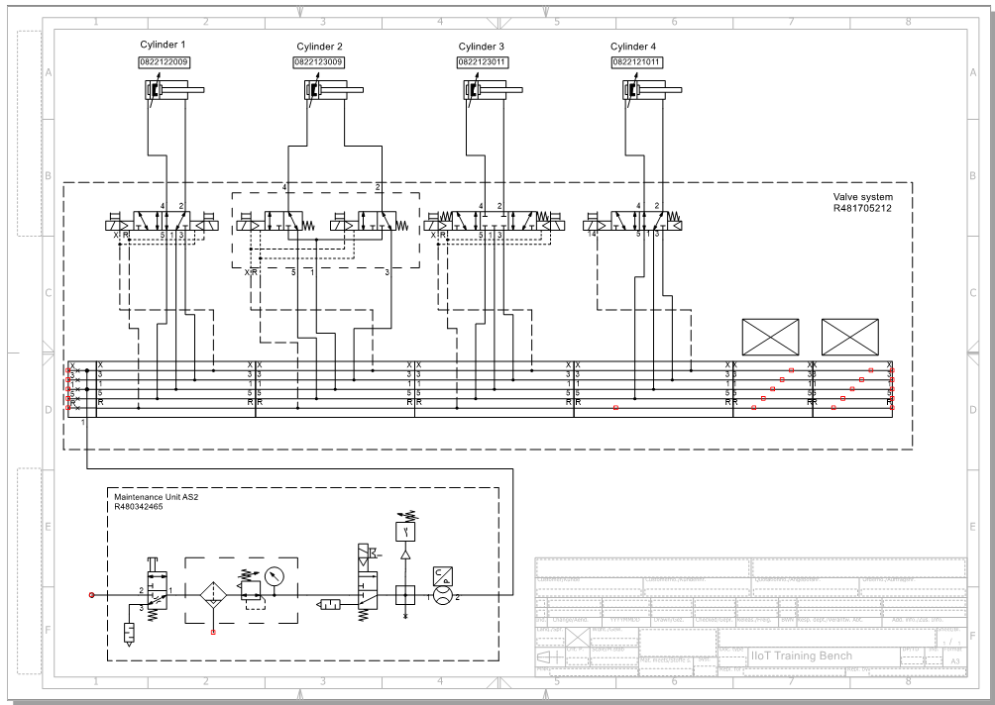
Pneumatic Sketch

Slide 5
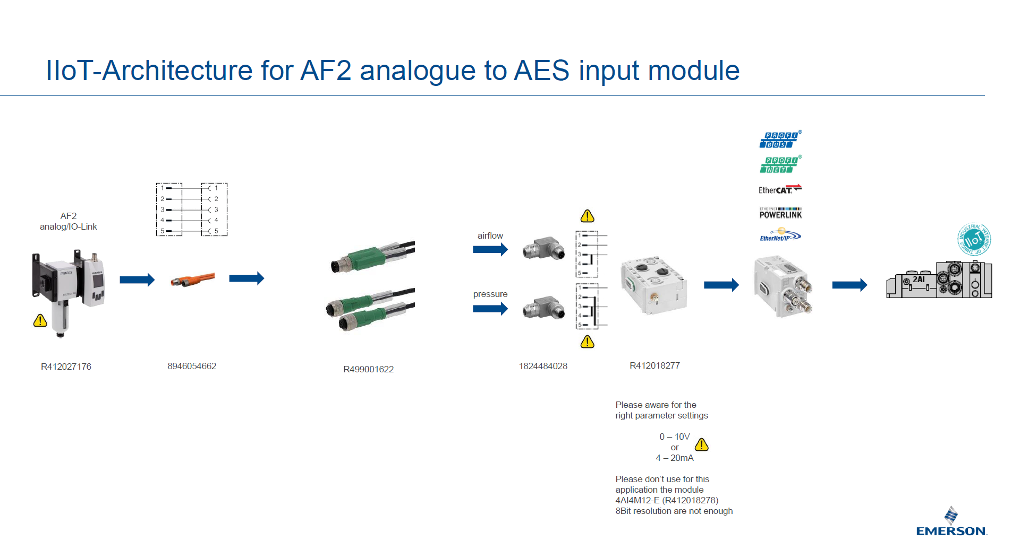

Slide 6
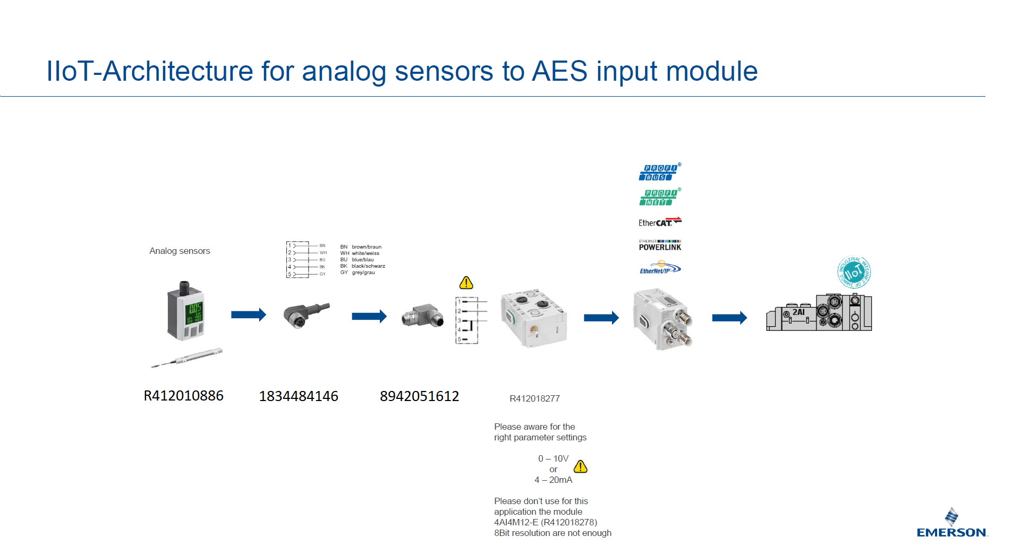

Slide 7
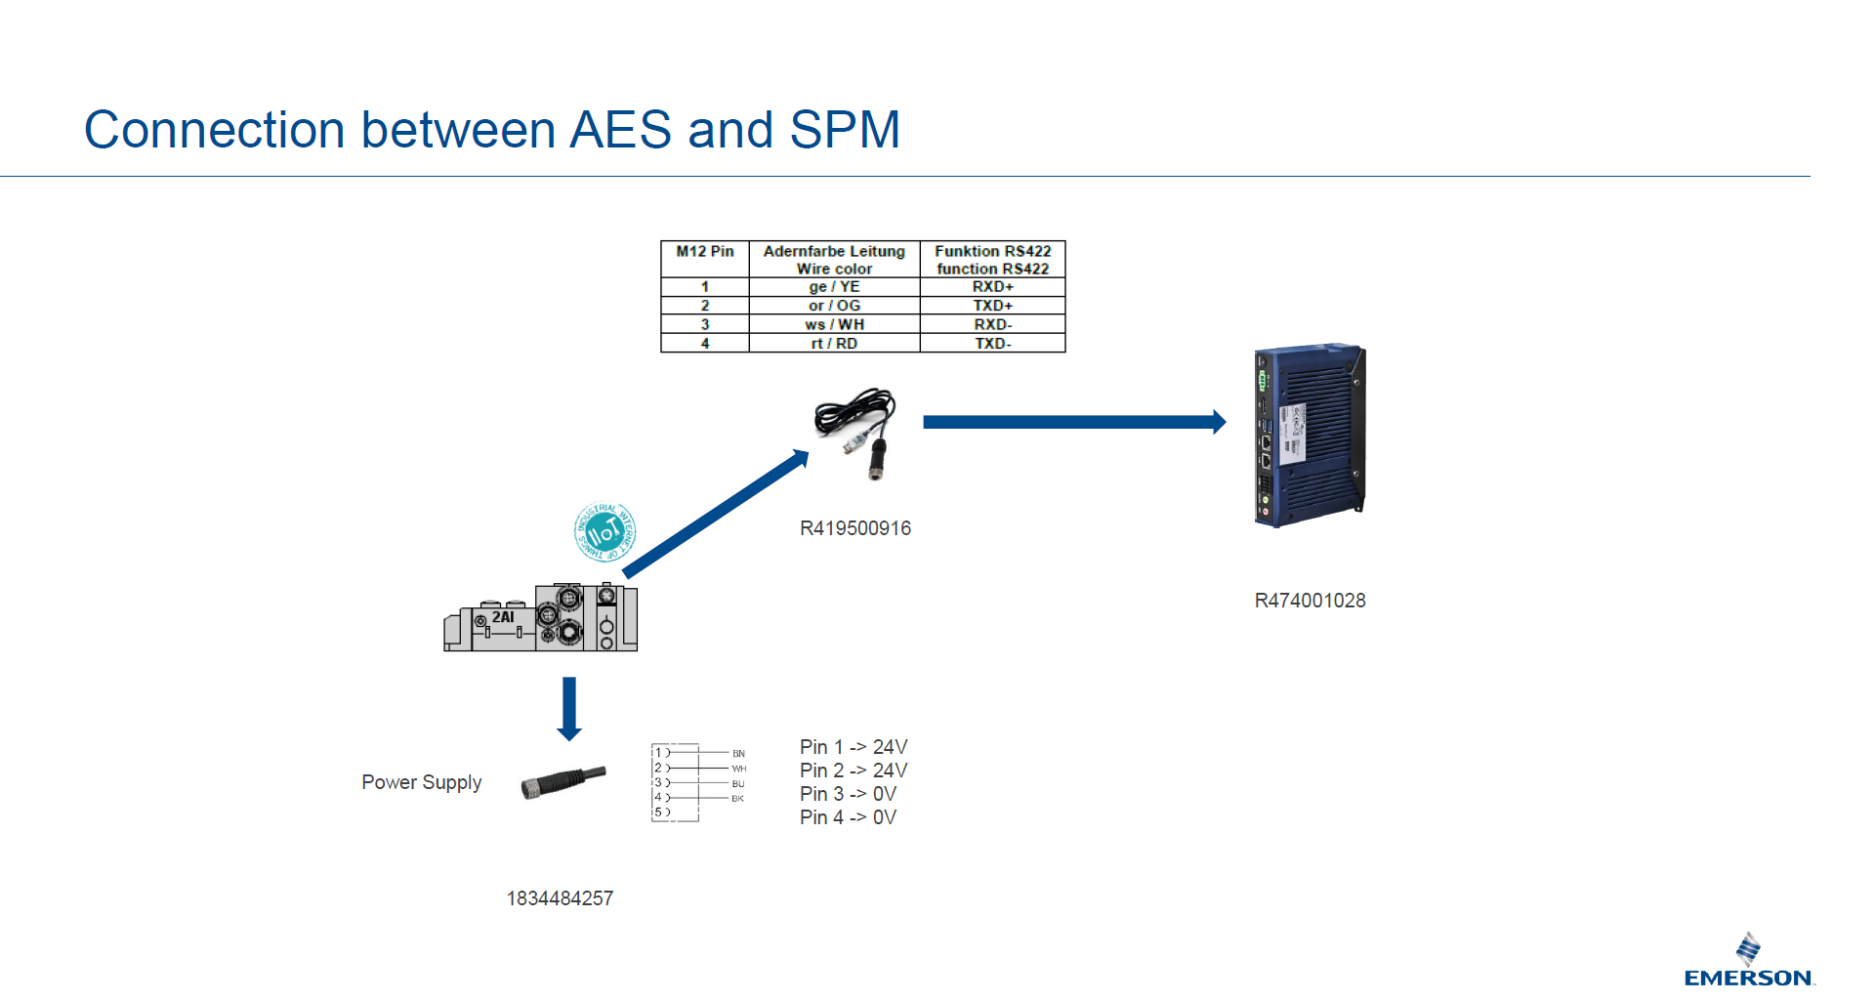

Slide 8
Hardware

Slide 9

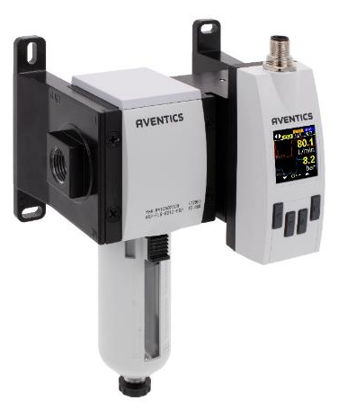
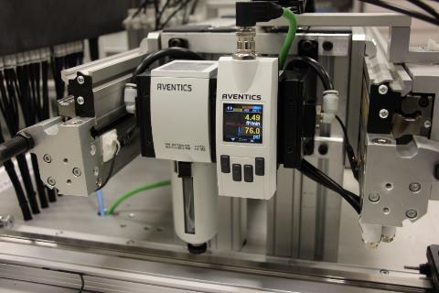
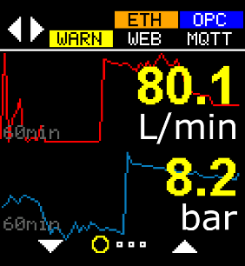
R480342465 - Maintenance unit with AF2 Air Flow Sensor
Variants AS2 / AS3 / AS5
Industrial: IO-Link / Analog / Frequency / Impulse / Switch
Ethernet: Webserver (Dashboard) / OPC UA / MQTT
Integrated statistics (min, max and mean)
Integrated counter (Volume, Mass, Energy)
Integrated logging (7d, 24h, 60min) readable via OPC UA
OLED Display with configurable values and graphs
Volumetric Flow Rate (L/min)
Pressure (bar)
Temperature (°C)
Mass Flow Rate (kg/h)
Flow Velocity (m/s)
Volume (L)
Mass (kg)
Energy (kWh)

Slide 10
R474001028 - Smart Pneumatics Monitoring
Gateway | RXi2-LP Edge
Computing Power | AMD x86, 2 Cores, 1.0GHz
RAM | 4GB RAM
Storage | 32GB SSD + microSD Slot
Based on Scalable Hardware Platform | ✔
Dimensions (H x D x W) | 193 x 130 x 42 mm 7.6 x 5.12 x 1.65 inch
DIN-Rail mount | ✔
RJ45 Ethernet | 2x 10/100/1000 Mbps
USB | 2x USB 3.0
WIFI | ✔ ^{via separate USB Dongle}
Operating temperature | -25 .. +55°C
Protection Class | IP20
Open Linux Architecture | ✔
Management UI | ✔
Docker support | ✔
OPC UA | ✔
MQTT | ✔
Modbus (TCP / RTU) | ✔ ^{direct} / ✔ ^{via separate USB Dongle}
Material number:
RXi2-LP
R474001028

Slide 11
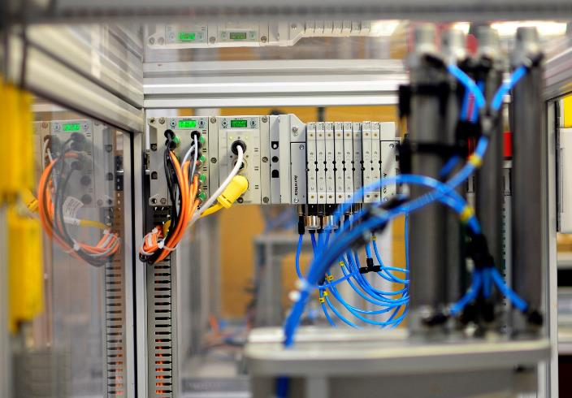
R481705212 – AV03 Valve System
Large variety of signals processed: Analog and digital input/output modules Analog combination modules Control modules Pressure measurement modules All relevant fieldbus protocols Consistent communication up to the valve Integrated web server Modular design Integrated graphic display providing plain-language diagnostics System can pre analyze data and can be used as data source. Connect with RXi2 Edge Gateway for further insights and analytics Uniquely configured for this project

Slide 12
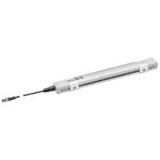
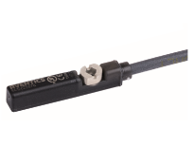
Sensors
 | AVENTICS AF2 Flow and Pressure Sensor – integrated in FRL IIoT data source for pressure analytics
 | AVENTICS SM6 Distance Sensor - R412010886 Measurement range setting from 107 to 1007 mm via teach-in button LED function indicator High precision: resolution 0.06 mm, scanning rate 1.15 ms IIoT data source for cylinder movement analysis
 | AVENTICS ST6 End-Position Sensor - R412022859 Mounting from above in the slot (“drop-in”) LED function indicator Shock and vibration-resistant IIoT data source for cylinder mileage

Slide 13
Summary of components
Component | MNR | QTY | QTY Unit
Maintenance unit with flow sensor | R480342465 | 1 | PC
Cable for AF2 | 8946054662 | 1 | PC
Diverter for AF2 | R499001622 | 1 | PC
Connector for AF2 | 1824484028 | 2 | PC
Valve system | R481705212 | 1 | PC
Cylinder switch ST6 | R412022859 | 8 | PC
SM6 320 | R412010886 | 1 | PC
Edge controller | R474001028 | 1 | PC
Cable for edge controller | R419500916 | 1 | PC
Software valve cycle counter | R407000102 | 1 | PC
Software cylinder cycle time | R407000100 | 1 | PC
Software air consumption | R407000103 | 1 | PC
Sensor cable ST6 | 8946203722 | 8 | PC
Sensor cable SM6 | 1834484146 | 1 | PC
Sensor plug SM6 | 8942051612 | 2 | PC
VTS supply cable | 1834484257 | 1 | PC
Check-Choke valve 1/4 D6 | R412010571 | 4 | PC
Check-Choke valve 3/8 D8 | R412010574 | 4 | PC
Tube D6 | R412009988 | 50 | M

Slide 14
Software

Slide 15
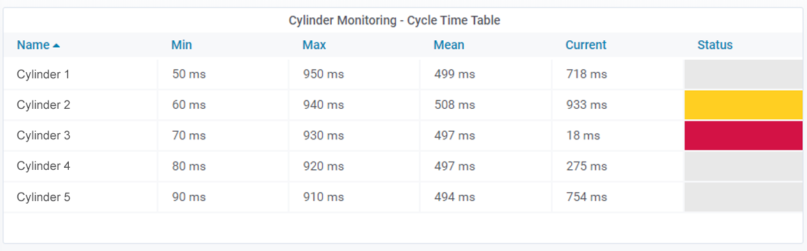
Cylinder Cycle Time
Material number: R407000100
Content: Node-RED + Grafana Import without Customer specific configuration
Cylinder Cycle Timetable
Min- and Max-Thresholds could be defined for each cylinder
Mean and Status are calculated with respect to the current measured time and the Thresholds
Color indicator

Slide 16
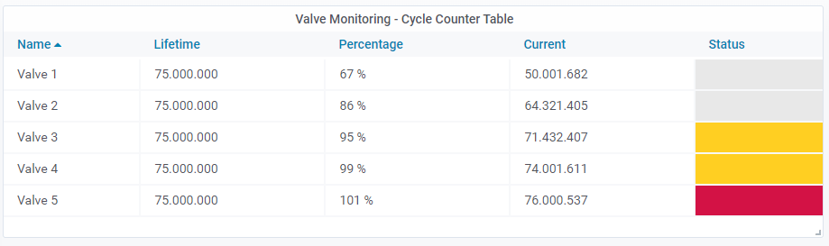
Valve Cycle Counter
Material number: R407000102
Content: Node-RED + Grafana Import without Customer specific configuration
Cycle Counter Table
Max-Thresholds could be defined
Percentage and Status are calculated with respect to the current measured time and the Thresholds
Color indicator

Slide 17
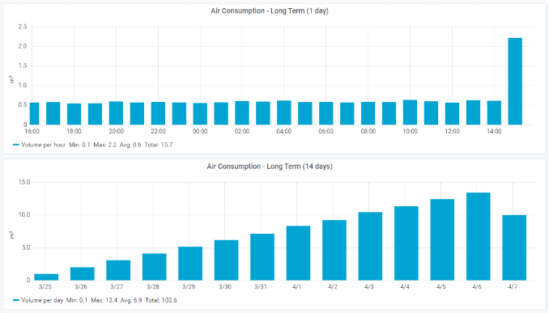
Air Consumption Long Term (Airflow as Source)
Material number: R407000103
Content: Node-RED + Grafana Import without Customer specific configuration
Long Term monitoring for 1 day or 14 days as a bar charts
Usage of Airflow as a Data Source
Statistical overview shows the min, max, average and Total Volume

Slide 18
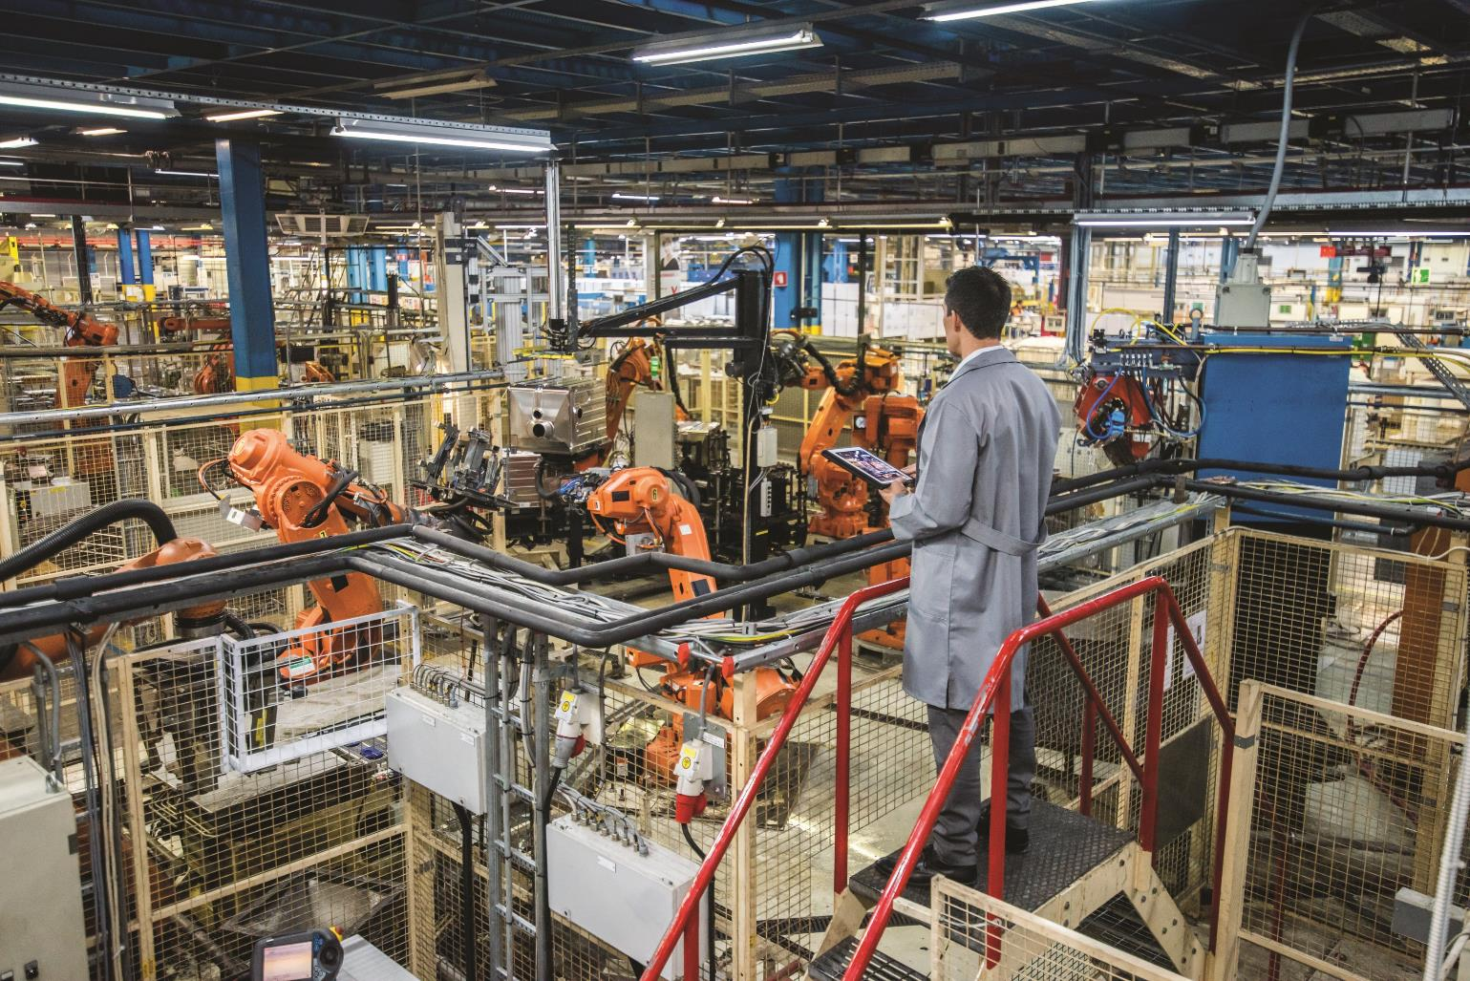

Digital Transformation
Let Us Guide You in Your Journey
Emerson Confidential

